Slide 1
CSC 63106 – Artificial Intelligence — Introduction to AI —
By Harriet Sibitenda
BCS

Slide 2
Outline
What is AI? Definitions (McCarthy, Minsky, modern)
Brief History Timeline: Turing (1950), Dartmouth (1956), neural networks, modern breakthroughs
Types of AI: Reactive, limited memory, theory of mind, self-aware
Applications Across Domains: Healthcare, finance, robotics, games, autonomous systems
Key Milestones & Models: Early systems to deep learning, generative AI
Tools & Languages: Python, scikit-learn, TensorFlow; (upcoming later weeks)

Slide 3

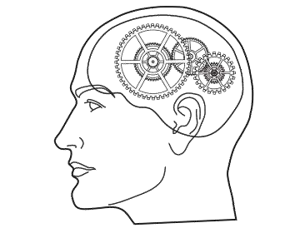
What is Artificial Intelligence ?
making computers that think?
the automation of activities we associate with human thinking, like decision making, learning ... ?
the art of creating machines that perform functions that require intelligence when performed by people ?
the study of mental faculties through the use of
computational models ?
a branch of computer science that is concerned with the automation of intelligent behaviour ?

Slide 4
Definition of AI
WHAT IS INTELLIGENCE?
The ability to learn and perform suitable techniques to solve problems and achieve goals, appropriate to the context in an uncertain, ever-varying world.
DEFINITION OF AI
Artificial Intelligence (AI), a term coined by emeritus Stanford Professor John McCarthy in 1955, was defined by him as “ the science and engineering of making intelligent machines ”.
AI is when a computer program makes decisions by mimicking the way a human thinks.
Much research has humans program machines to behave in a clever way, like playing chess, but, today, we emphasize machines that can learn, at least somewhat like human beings do.

Slide 5
Early History of AI
1950: Alan Turing publishes Computing Machinery and Intelligence. In the paper, Turing—famous for breaking the Nazi's ENIGMA code during WWII—proposes to answer the question 'can machines think?’
1956: John McCarthy coins the term 'artificial intelligence' at the first-ever AI conference at Dartmouth College.
1967: Frank Rosenblatt builds the Mark 1 Perceptron, the first computer based on a neural network that 'learned' though trial and error.
1980s: Neural networks which use a backpropagation algorithm to train itself become widely used in AI applications.
1997: IBM's Deep Blue beats then world chess champion Garry Kasparov, in a chess match (and rematch).
2011: IBM Watson beats champions Ken Jennings and Brad Rutter at Jeopardy!
2015: Baidu's Minwa supercomputer uses a special kind of deep neural network called a convolutional neural network to identify and categorize images with a higher rate of accuracy than the average human.
2016: DeepMind's AlphaGo program, powered by a deep neural network, beats Lee Sodol, the world champion Go player, in a five-game match.

Slide 6
Current status of AI
In 2021, AI investments by corporations and businesses, large and small, have reached new heights, exceeding all previous expectations and predictions.
AI-based software systems are comprised of many layers such as foundational models, advanced algorithms, and automated reasoning tools.
Language processing and conversation interfaces are already able to deliver translation services, text understanding and categorization, speech recognition, and even power chatbots.
DALL.E and GPT3 are large-scale models that have achieved remarkable results in computer vision and natural language processing (NLP).
By 2025, multimodal AI systems (text, image, audio, video) have become mainstream, powering tools like GPT-4/5, Gemini, and Claude.
AI agents are now capable of autonomous task execution—planning, reasoning, and interacting across applications without human step-by-step instructions.
Generative AI is widely adopted in education, healthcare, law, and creative industries, supporting personalized tutoring, medical diagnostics, and content creation.
AI safety, ethics, and regulation have become major priorities, with governments and international organizations enforcing responsible AI usage.
Edge AI and on-device processing are reducing reliance on cloud-only models, improving privacy and accessibility.

Slide 7
Future of AI
The reason why is simple: if you can replace one person with an AGI system, you don’t need one computer to do the work – you can spread it out across thousands or millions of computers.
AI is helping to achieve this reality by making objects look more realistic and enabling computer vision so users can interact with simulated objects using their body movements.
Artificial general intelligence (AGI), the kind of AI capable of doing any intellectual task that a human being can do but we’re already starting to see plenty of progress in other areas of AI.
It is already the primary driver of developing technologies such as big data, robots and the Internet of Things and it will continue to be a technical pioneer in the foreseeable future.

Slide 8
How does AI work?
AI requires a foundation of specialized hardware and software for
writing and training machine learning algorithms.
In general, AI systems work by ingesting large amounts of labeled training data, analyzing the data for correlations and patterns, and using these patterns to make predictions about future states.
AI programming focuses on three cognitive skills: learning,
reasoning and self-correction.
Learning: This aspect of AI programming focuses on acquiring data and creating rules for how to turn the data into actionable information.
Reasoning: This aspect of AI programming focuses on choosing
the right algorithm to reach a desired outcome.
Self-Correction: This aspect of AI programming is designed to continually fine-tune algorithms and ensure they provide the most accurate results possible.

Slide 9
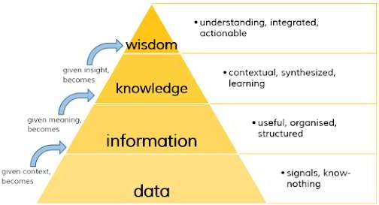
Processes in Artificial Intelligence

Slide 10
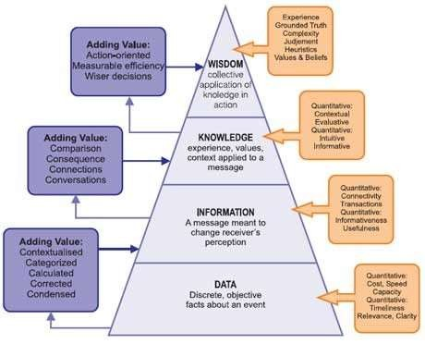
Processes in Artificial Intelligence
Processes in Artificial Intelligence

Slide 11
Processes in Artificial Intelligence
Data:
Data refers to raw facts or figures that exist without context or meaning. It can appear in any form, usable or not, and has no inherent significance on its own. In computing, for example, a spreadsheet typically begins by simply holding data.
Information:
Information is data that has been processed or organized in a way that provides meaning through relationships or context. This meaning may or may not be useful, depending on how it’s applied. In computing terms, a relational database transforms stored data into information by creating these connections.
Knowledge:
knowledge is the appropriate collection of information, such that it's intent is to be useful.
Knowledge is a deterministic process.
Knowledge has useful meaning to them, but it does not provide for, in and of itself, an integration such as would infer further knowledge.
In computer parlance, most of the applications we use (modeling, simulation, etc.) exercise some type of stored knowledge.

Slide 12
Processes in Artificial Intelligence
Wisdom:
Wisdom is an predictive and non-deterministic, non- probabilistic process.
It calls upon all the previous levels of consciousness, and specifically upon special types of human programming (moral, ethical codes, etc.).
It beckons to give us understanding about which there has previously been no understanding, and in doing so, goes far beyond understanding itself.
Wisdom is therefore, the process by which we also distinguish, or judge, between right and wrong, good and bad.
Wisdom is a uniquely human state, or as I see it, wisdom requires one to have a soul, for it resides as much in the heart as in the mind. And a soul is something machines will never possess.

Slide 13
Goals of AI
It helps you reduce the amount of time needed to perform specific tasks.
Making it easier for humans to interact with machines.
Knowledge representation and knowledge engineering are central to AI research.
Facilitating human-computer interaction in a way that is more natural and efficient.
Improving the accuracy and speed of medical diagnoses.
Helping people learn new information more quickly.
Enhancing communication between humans and machines.
Effective computing is the study and development of systems that can detect, interpret, process, and simulate human.
To Create Expert Systems − The systems which exhibit intelligent behavior, learn, demonstrate, explain, and advice its users.

Slide 14
Some Advantages of Artificial Intelligence
more powerful and more useful computers
new and improved interfaces
solving new problems
relieves information overload
conversion of information into knowledge
Reduction in Human Error
Zero Risks
24x7 Availability Digital Assistance
Unbiased Decisions
Perform Repetitive Jobs
Daily Applications
AI in Risky Situations

Slide 15
How safe is AI?
AI could soon impact every sector of our life. It will improve our safety, but we have to remember: we cannot rely on an algorithm to protect us in every instance.
In some cases, we will need to leave the final decision to a human.
Fully self-driving cars are now a reality. Tesla is the first company to make a car with all of the sensors, cameras, and software needed for a computer to drive itself from start to finish.
Predictive analytics (or forecasting) applies artificial intelligence using machine learning and statistical techniques to make predictions about future events based on previous data.

Slide 16
Risks of AI
job losses due to ai automation
social manipulation through ai algorithms
social surveillance with ai technology
biases due to artificial intelligence
widening socioeconomic inequality as a result of ai
weakening ethics and goodwill because of ai
autonomous weapons powered by artificial intelligence
financial crises brought about by ai algorithms

Slide 17
Programming Without and With AI
Programming Without AI | Programming With AI
A computer program without AI can answer the specific questions it is meant to solve. | A computer program with AI can answer the generic questions it is meant to solve.
Modification in the program leads to change in its structure. | AI programs can absorb new modifications by putting highly independent pieces of information together. Hence you can modify even a minute piece of information of program without affecting its structure.
Modification is not quick and easy. It may lead to affecting the program adversely. | Quick and Easy program modification.

Slide 18
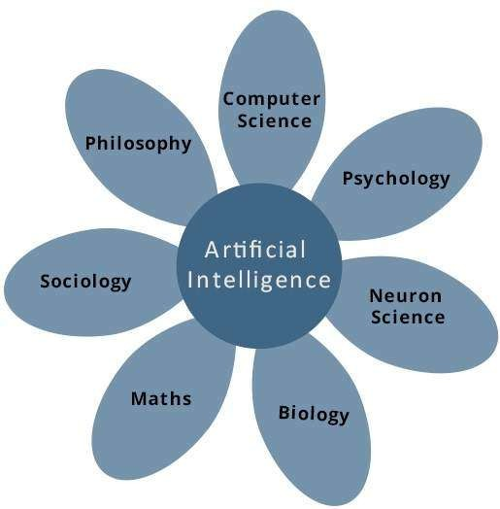
What Contributes to AI?

Slide 19
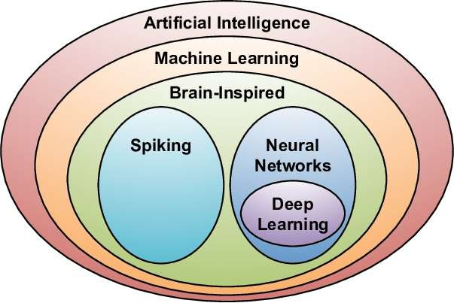
Major Sub-fields of AI
Artificial Intelligence (AI) is the general term for being able to make computers do things that require intelligence if done by humans.
Machine Learning (ML) makes computers learn from data and experience to improve their performance on some tasks or decision-making processes.
ML can be defined as a set of technologies and methods for finding rules when they are too complex to define – they find rules, learn, and make predictions from data without being explicitly programmed to do so.
Deep learning is a subset of machine learning that uses multi-layered artificial neural networks to deliver state-of-the-art accuracy in object detection, speech recognition and language translation.

Slide 20
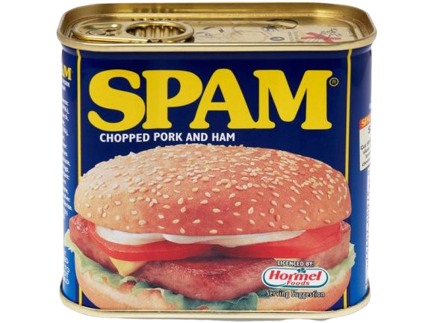



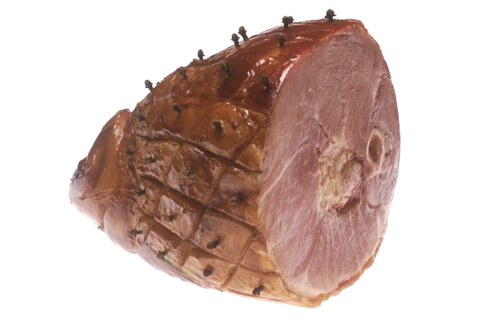
AI example: Email SPAM filter
Early SPAM filters:
Manually programmed set of rules
Containing certain words
Coming from list of flagged IP addresses
Etc.
Any updates required a programmer to update the code
A rule-based SPAM filter mimics a human recognizing suspicious email, so it is AI, but it is not Machine Learning.

Slide 21

ML example: SPAM filter
In modern Machine Learning version of SPAM filter:
Dataset of emails labeled by humans as SPAM or not-SPAM is constructed
Dataset is input into a machine learning algorithm, which trains a model
As users report SPAM that made it through filter, emails can be added to dataset, and model retrained.

Slide 22
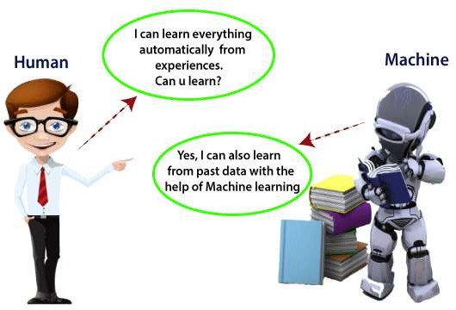
Concepts in Artificial Intelligence
Machine learning:

Slide 23
Activity: Which of the following applications are ML, AI, or neither?
A headset that allows visitors to explore a VR recreation of a dinosaur fossil field site
A search system that looks for images similar to a user submitted sketch.
A system that recommends library books based on what other users have ordered.
A queueing system that spreads people evenly between 5 ticket booths
A program which extracts names from documents by finding all capitalised words and checking them against a list of known names
A system which turns digitized handwritten documents into searchable text
A robot which cleans the vases in a museum without bumping into them or breaking them

Slide 24
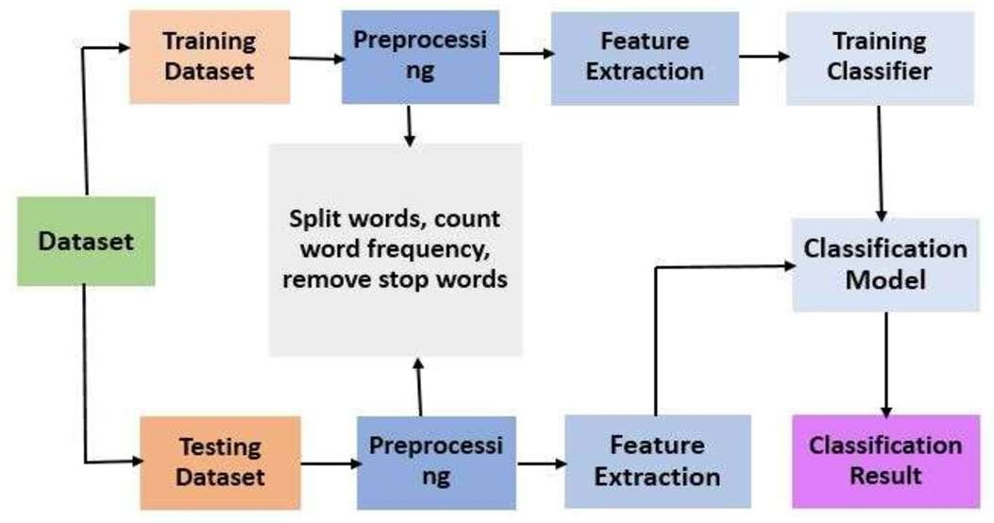
Concepts in Artificial Intelligence
Machine learning: Machine learning is a growing technology which enables
computers to learn automatically from past data.
Machine learning uses various algorithms for building mathematical models and making predictions using historical data or information.

Slide 25
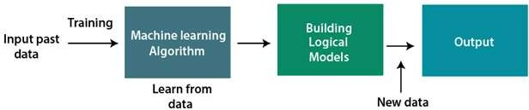
Concepts in Artificial Intelligence
Machine learning:
machine learning is a rapidly evolving technology that allows computers to automatically learn from past data without explicit programming.
it is applied in many areas, including image recognition, speech recognition, email filtering, facebook auto-tagging, recommender systems, and more.
machine learning methods include supervised learning, unsupervised learning, and reinforcement learning.
topics you will explore include regression and classification models, clustering algorithms, hidden markov models, and other sequential models.
basic process:

Slide 26
Concepts in Artificial Intelligence
Machine learning
Features of Machine Learning:
Machine learning uses data to detect various patterns in a given dataset.
It can learn from past data and improve automatically.
It is a data-driven technology.
Machine learning is much similar to data mining as it also deals with
the huge amount of the data.
Classification of Machine Learning
Supervised learning
Unsupervised learning
Reinforcement learning

Slide 27

Concepts in Artificial Intelligence
Supervised learning Machine learning
Supervised learning, as the name indicates, has the presence of a supervisor
as a teacher.
Basically supervised learning is when we teach or train the machine using data that is well labeled. Which means some data is already tagged with the correct answer.
After that, the machine is provided with a new set of examples(data) so that the supervised learning algorithm analyses the training data (set of training examples) and produces a correct outcome from labeled data.
For instance, suppose you are given a basket filled with different kinds of fruits. Now the first step is to train the machine with all different fruits one by one like this:
If the shape of the object is rounded and has a
depression at the top, is red in color, then it will be labeled as –Apple.
If the shape of the object is a long curving cylinder having Green-Yellow color, then it will be labeled as –Banana

Slide 28
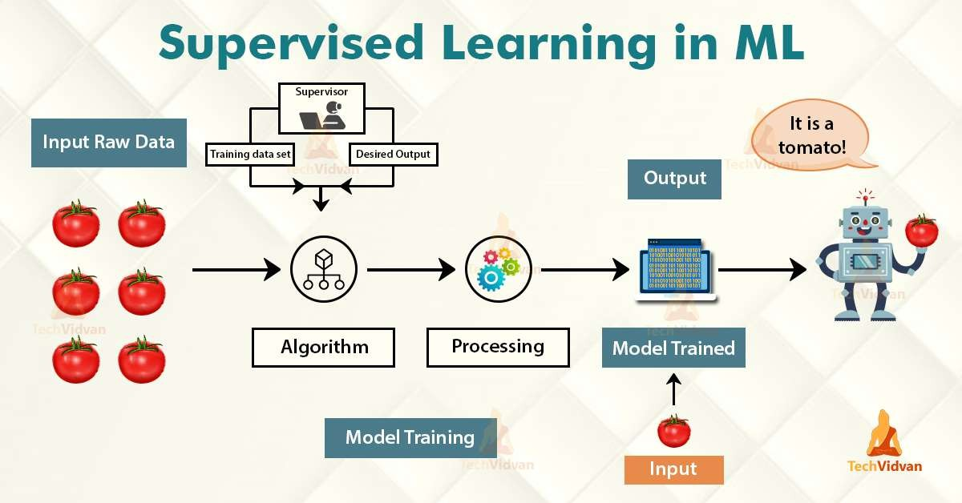
Concepts in Artificial Intelligence
Unsupervised learning Machine learning
Unsupervised can be further classifieds into two categories of algorithms:
Clustering
Association

Slide 29
Concepts in Artificial Intelligence
Supervised learning Machine learning
Supervised learning classified into two categories of algorithms:
Classification: A classification problem is when the output variable is a category, such as “Red” or “blue” or “disease” and “no disease”.
Regression: A regression problem is when the output variable is a real value, such as “dollars” or “weight”.
Advantages Supervised learning Machine learning:-
Supervised learning allows collecting data and produces data output from previous experiences.
Helps to optimize performance criteria with the help of experience.
Supervised machine learning helps to solve various types of real-world
computation problems.
Disadvantages:-
Classifying big data can be challenging.
Training for supervised learning needs a lot of computation time. So, it requires a lot of time.

Slide 30
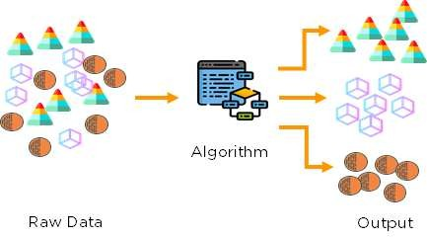
Concepts in Artificial Intelligence
Unsupervised learning Machine learning
Unsupervised learning is classified into two categories of algorithms:
Clustering: A clustering problem is where you want to discover the inherent groupings in the data, such as grouping customers by purchasing behavior.
Association: An association rule learning problem is where you want to discover rules that describe large portions of your data, such as people that buy X also tend to buy Y.

Slide 31
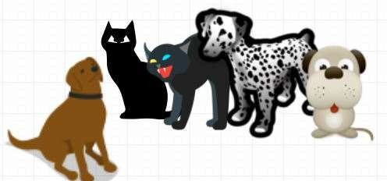
Concepts in Artificial Intelligence
Unsupervised learning Machine learning
Unsupervised learning is the training of a machine using information that is neither classified nor labeled and allowing the algorithm to act on that information without guidance.
Here the task of the machine is to group unsorted information according to similarities, patterns, and differences without any prior training of data.
Unlike supervised learning, no teacher is provided that means no training will be given to the machine. Therefore the machine is restricted to find the hidden structure in unlabeled data by itself.
For instance, suppose it is given an image having both dogs and cats which it has never seen.
Thus the machine has no idea about the features of dogs and cats so we can’t categorize it as ‘dogs and cats‘.
But it can categorize them according to
their similarities, patterns,
and differences, i.e., we can easily
categorize the above picture into two
parts.

Slide 32
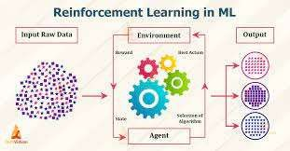
Concepts in Artificial Intelligence
Reinforcement learning Machine learning
Unsupervised can be further classifieds into two categories of algorithms:
Clustering
Association

Slide 33
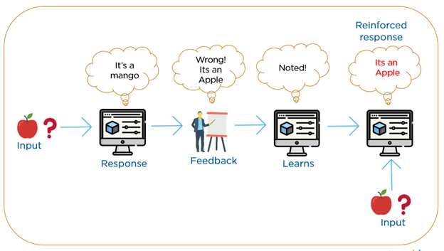
Concepts in Artificial Intelligence
Reinforcement learning Machine learning
Unsupervised can be further classifieds into two categories of algorithms:
Clustering
Association

Slide 34
Concepts in Artificial Intelligence
Reinforcement Machine learning
Reinforcement Learning is a feedback-based Machine learning technique in which an agent learns to behave in an environment by performing the actions and seeing the results of actions.
For each good action, the agent gets positive feedback, and for each bad action, the agent gets negative feedback or penalty.
In Reinforcement Learning, the agent learns automatically using feedbacks
without any labeled data, unlike supervised learning.
Since there is no labeled data, so the agent is bound to learn by its experience only.
RL solves a specific type of problem where decision making is sequential,
and the goal is long-term, such as game-playing, robotics, etc.
The agent interacts with the environment and explores it by itself. The primary goal of an agent in reinforcement learning is to improve the performance by getting the maximum positive rewards.

Slide 35

Deep Learning
Neural networks are made up of several connected "neurons", which are individual models that feed into each other.
A lot of the previously mentioned algorithms can be represented as neural networks, but when you start layering these networks together you get "deep learning"
AI
ML
Deep Learning

Slide 36
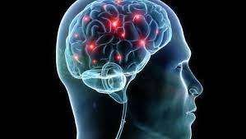
Neural networks in Artificial Intelligence
Neurons in human brain and pathways

Slide 37
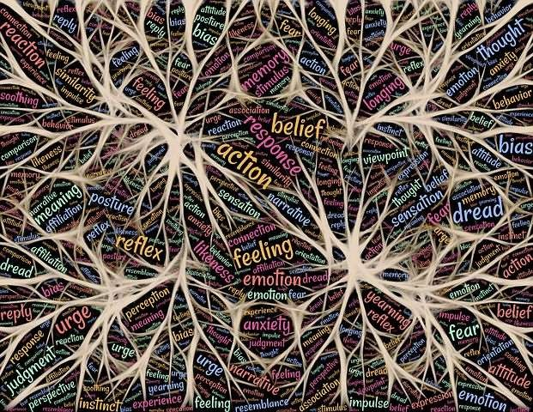
Neural networks in Artificial Intelligence
Neurons in human brain and pathways

Slide 38
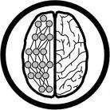
How do ANNs work?
An artificial neural network (ANN) is either a hardware implementation or a computer program which strives to simulate the information processing capabilities of its biological exemplar. ANNs are typically composed of a great number of interconnected artificial neurons. The artificial neurons are simplified models of their biological counterparts.
ANN is a technique for solving problems by constructing software that works like our brains.

Slide 39
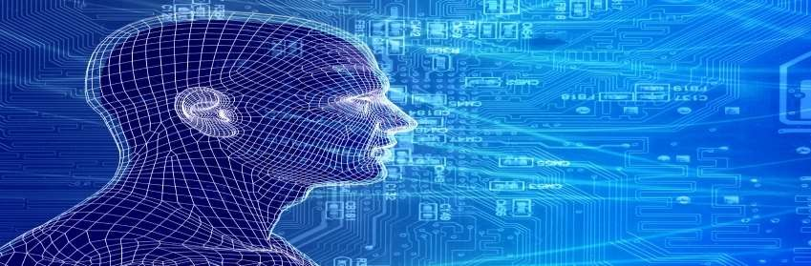
How do our brains work?
The Brain is A massively parallel information processing system.
Our brains are a huge network of processing elements. A typical brain contains a network of 10 billion neurons.

Slide 40
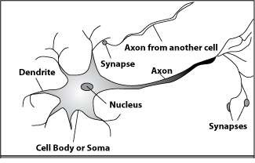
How do our brains work?
A processing element
Dendrites: Input Cell body: Processor Synaptic: Link Axon: Output

Slide 41
How do our brains work?
A processing element
A neuron is connected to other neurons through about 10,000 synapses
A neuron receives input from other neurons. Inputs are combined.
Once input exceeds a critical level, the neuron discharges a spike ‐ an electrical pulse that travels from the body, down the axon, to the next neuron(s)
The axon endings almost touch the dendrites or cell body of the next neuron.
Transmission of an electrical signal from one neuron to the next is effected by neurotransmitters.
Neurotransmitters are chemicals which are released from the first neuron and which bind to the second.
This link is called a synapse. The strength of the signal that reaches the next neuron depends on factors such as the amount of neurotransmitter available.

Slide 42
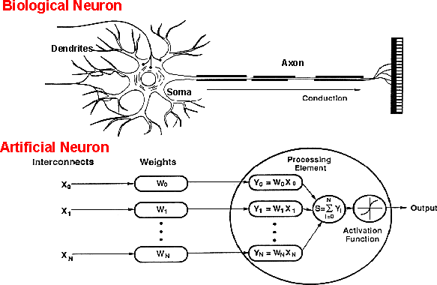
How do ANNs work?
An artificial neuron is an imitation of a human neuron

Slide 43
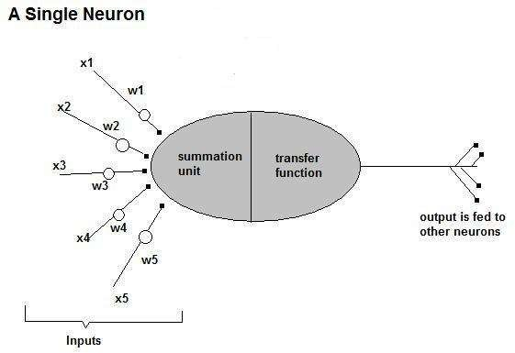
How do ANNs work?
Now, let us have a look at the model of an artificial neuron.

Slide 44
How do ANNs work?
Input
xm
. . . . . . .
. . . . .
x2
x1
Processing
∑
∑= X₁+X₂ + ….+X_{m} =y
Output
y

Slide 45
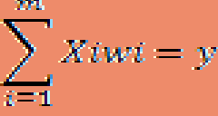
How do ANNs work?
Not all inputs are equal
xm
. . . . . . .
. . . . .
x2
x1
Input
weights
Processing
w_{m}
. . .
. .
w₂
w₁
∑
∑= X₁w₁+X₂w₂ + ….+X_{m}w_{m}
=y
Output
y

Slide 46
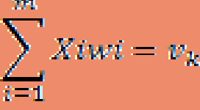

How do ANNs work?
The signal is not passed down to the next neuron verbatim
xm . . . . . . .
. . . . .
x2 x1
Input
weights
Processing
w
. . .
. .
w₂
w₁
m
∑
Transfer Function
(Activation Function)
f(v_{k})
Output
y

Slide 47
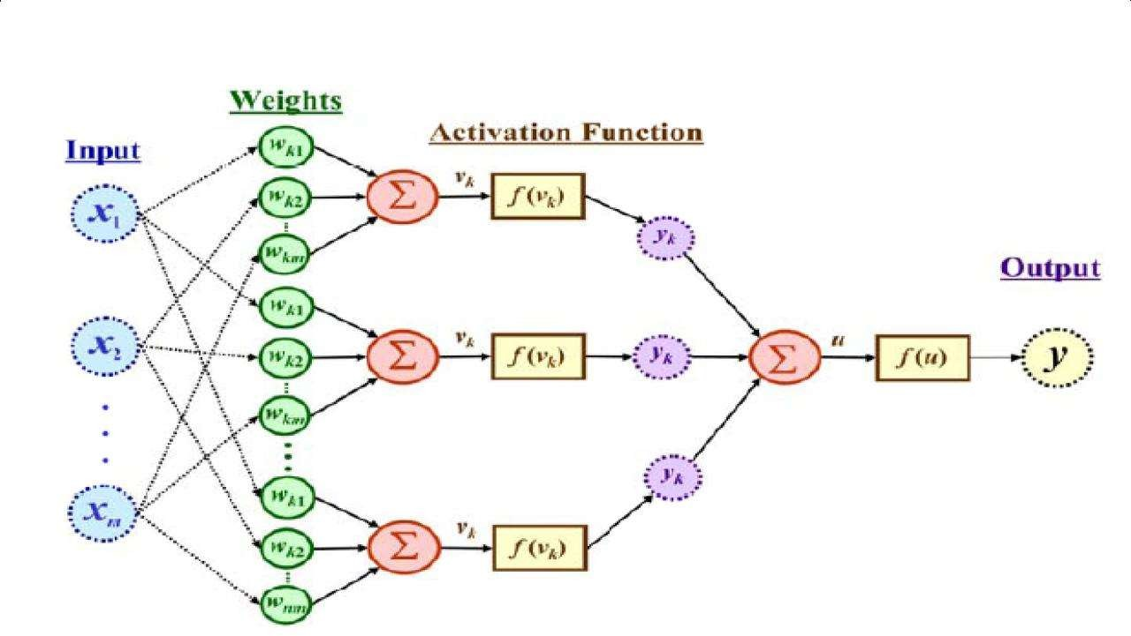
The output is a function of the input, that is affected by the weights, and the transfer functions

Slide 48
Artificial Neural Networks
An ANN can:
compute any computable function, by the appropriate selection of the network topology and weights values.
learn from experience!
Specifically, by trial‐and‐error

Slide 49
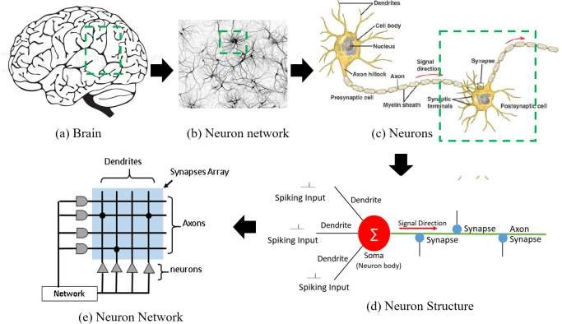
Neural networks in Artificial Intelligence
Neurons in human brain and pathways

Slide 50
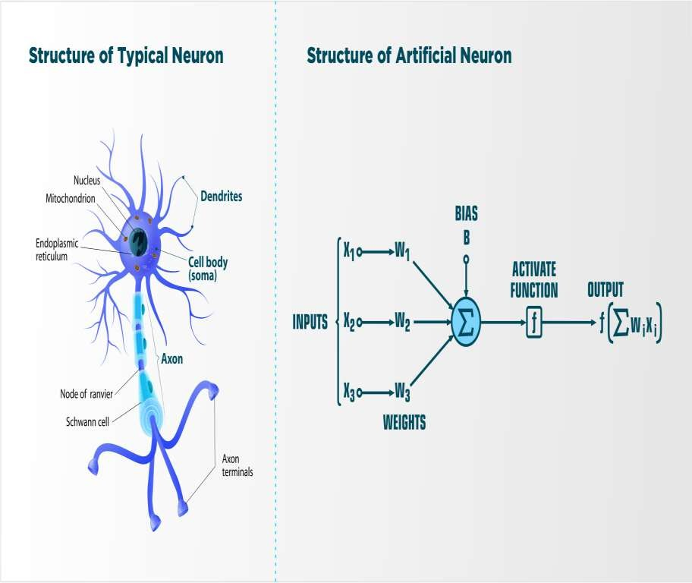
Neural networks in Artificial Intelligence
Neurons in human brain and pathways

Slide 51
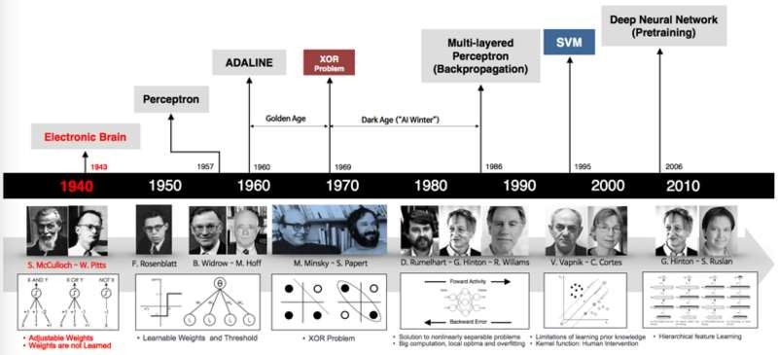
Neural networks in Artificial Intelligence
The history of Neural Networks

Slide 52
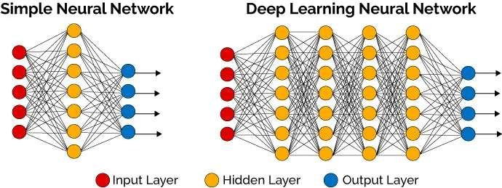
Deep Learning in Neural Networks

Slide 53
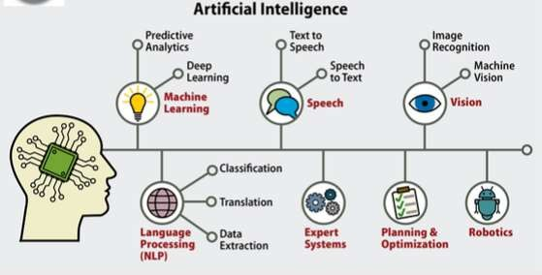
Scope of Artificial Intelligence

Slide 54
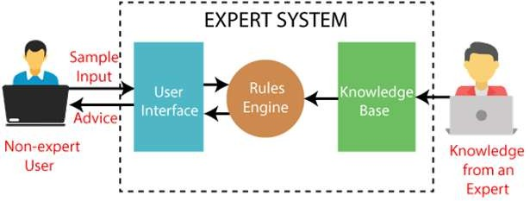
Scope of Artificial Intelligence

Slide 55
The main topics in AI
Artificial intelligence can be considered under a number of headings:
Search (includes Game Playing).
Representing Knowledge and Reasoning with it.
Planning.
Learning.
Natural language processing.
Expert Systems.
Interacting with the Environment
(e.g. Vision, Speech recognition, Robotics)
We won’t have time in this course to consider all of these.

Slide 56
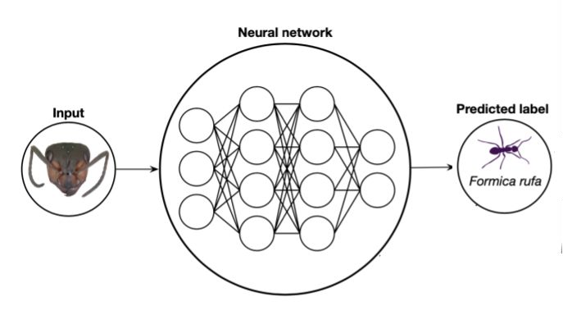
Computer Vision
Computer Vision is the application of algorithms to images.
The pixel values and transformations of those values produce the layers of a deep learning network.

Slide 57
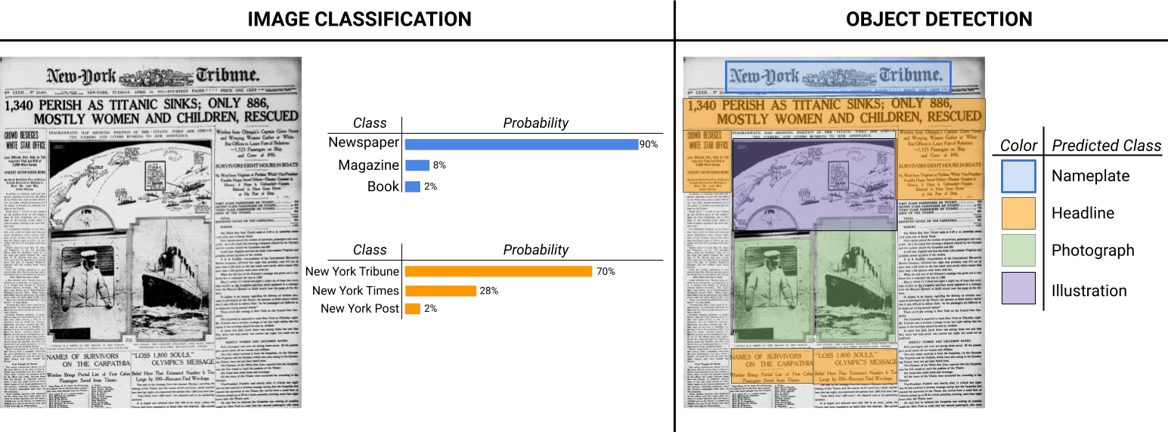
Computer Vision Tasks

Slide 58
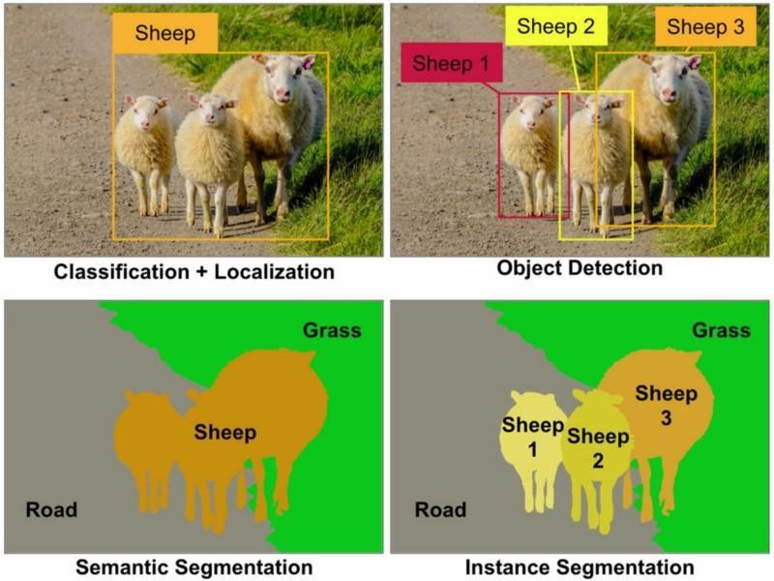
Computer Vision Tasks

Slide 59
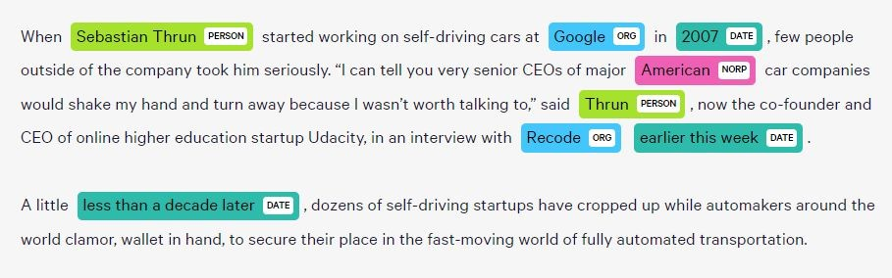
Natural Language Processing (NLP) Tasks
"That workshop was terrible"
"I'm not really sure what to think"
Sentiment Classification or Regression
Named Entity Recognition (NER)
Language Translation
Information Summarization

Slide 60
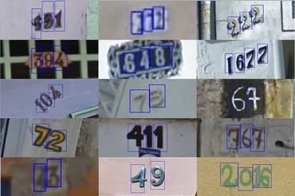
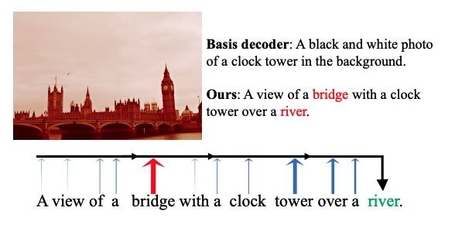
NLP + CV: Multimodal
Optical Character Recognition (OCR)
Image description or captioning

Slide 61
Audio
Automatic Speech Recognition (ASR), also known as Speech to Text (STT), is the task of transcribing a given audio to text.
Audio classification is the task of assigning a label to a given audio. It can be used for recognizing what language is being spoken, or the emotion of a statement, as well as identifying a speaker.

Slide 62
Activity
Now that we’ve talked about some of the ways that AI/ML could be used,
Spend 5 minutes in small groups/pairs thinking about and deciding on a machine learning project your group would be keen to start up using your collections/research.

Slide 63
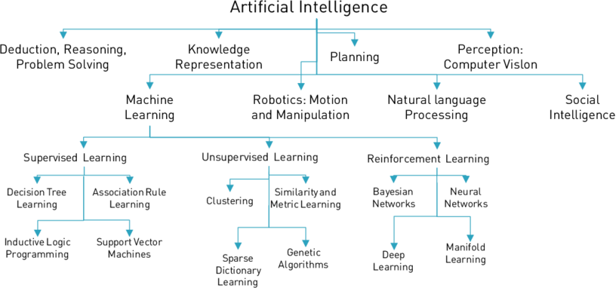
Artificial Intelligence Techniques

Slide 64
Artificial Intelligence Approach
Like HUMAN RATIONAL
THOUGHT
Systems that think like humans | Systems that think rationally
Systems that act like humans | Systems that act rationally
BEHAVIOUR

Slide 65
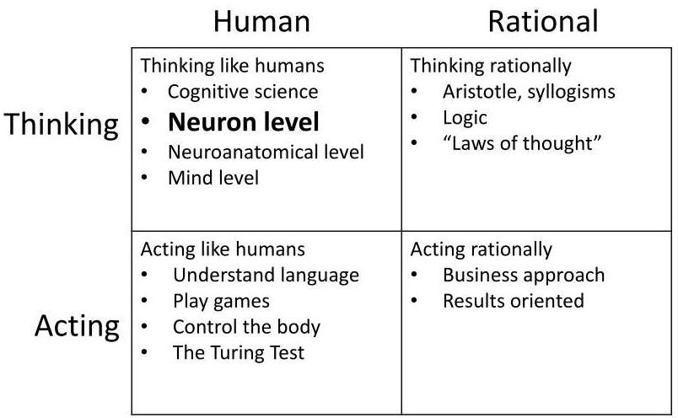
Artificial Intelligence Approach

Slide 66
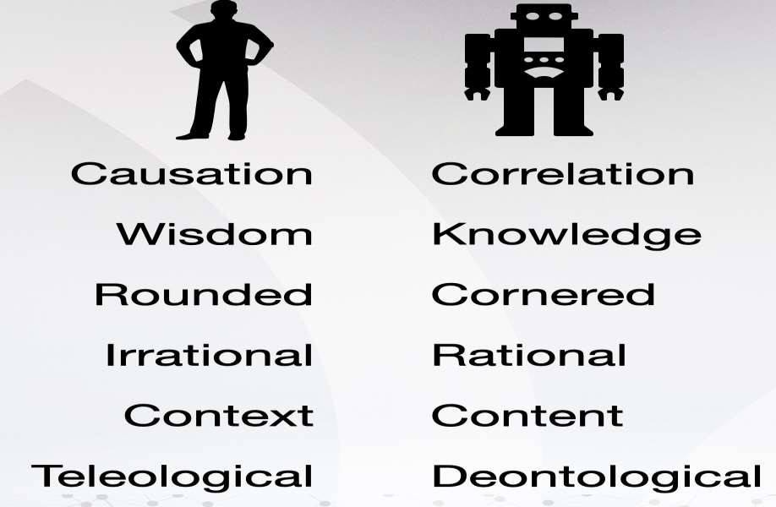
Artificial Intelligence Approach

Slide 67
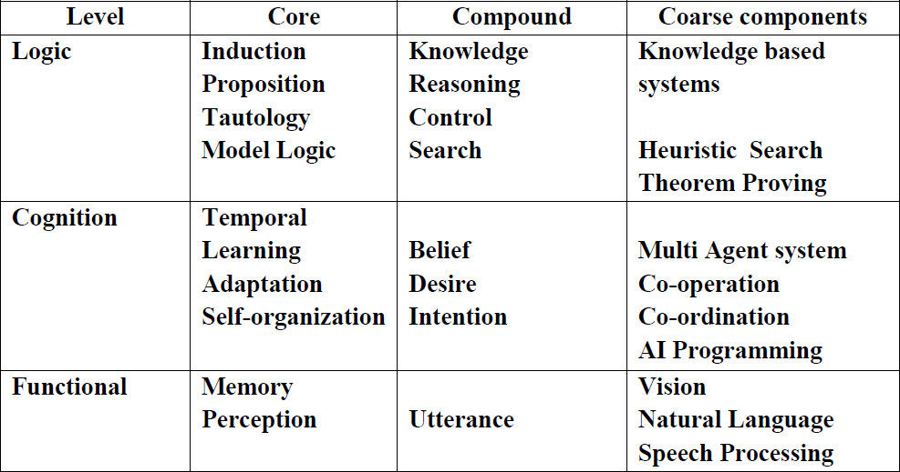
Components of Artificial Intelligence

Slide 68
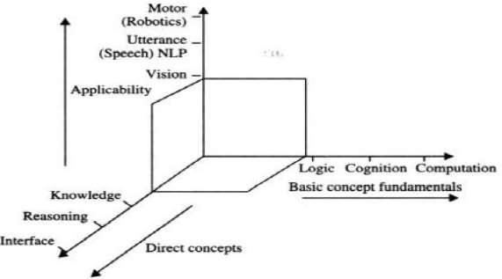
Three dimensional model of artificial intelligence

Slide 69
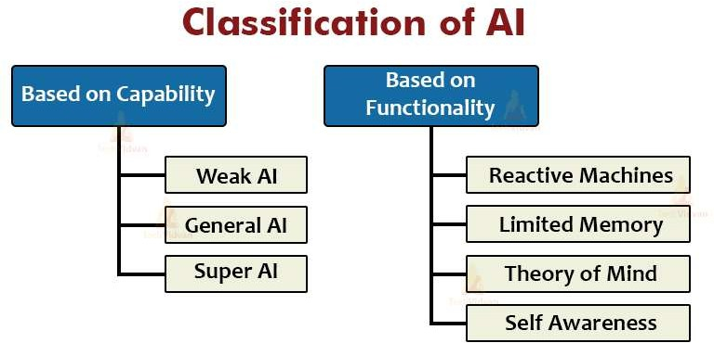
Types of artificial intelligence

Slide 70
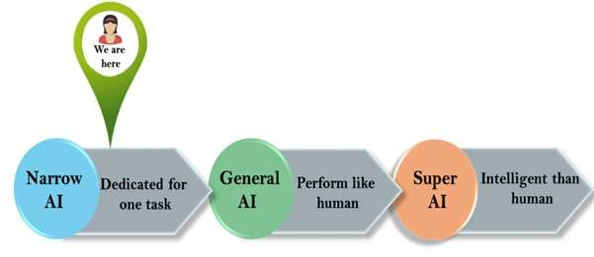
Types of artificial intelligence
AI type-1: Based on Capabilities

Slide 71
Types of Artificial Intelligence
AI type-1: Based on Capabilities
1. Weak AI or Narrow AI:
Narrow AI is a type of AI which is able to perform a dedicated task with intelligence. The most common and currently available AI is Narrow AI in the world of Artificial Intelligence.
Narrow AI cannot perform beyond its field or limitations, as it is only trained for one specific task. Hence it is also termed as weak AI. Narrow AI can fail in unpredictable ways if it goes beyond its limits.
Apple Siriis a good example of Narrow AI, but it operates with a limited pre-defined range of functions.
IBM's Watson supercomputer also comes under Narrow AI, as it uses an Expert system approach combined with Machine learning and natural language processing.
Some Examples of Narrow AI are playing chess, purchasing suggestions on e-commerce site, self-driving cars, speech recognition, and image recognition.

Slide 72
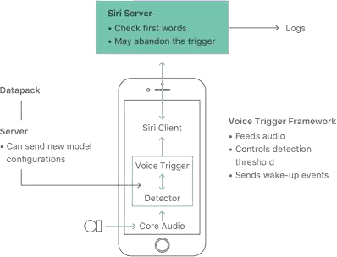
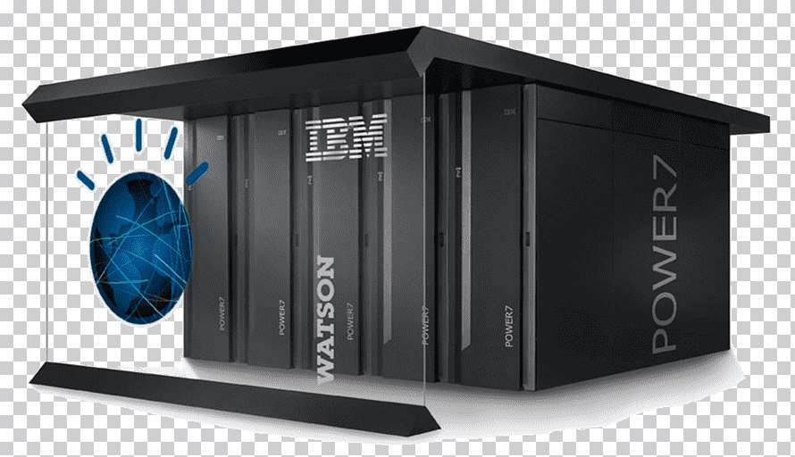
Types of artificial intelligence
AI type-1: Based on Capabilities
1. Weak AI or Narrow AI:

Slide 73
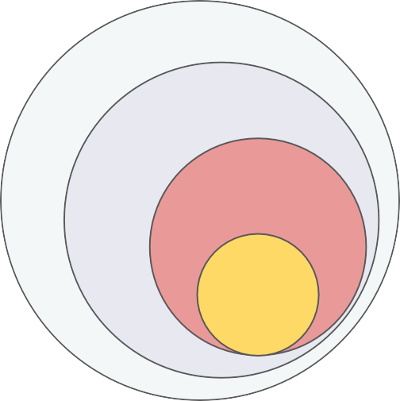
Types of artificial intelligence
AI type-1: Based on Capabilities
2. General AI:
General AI is a type of intelligence which could perform any
intellectual task with efficiency like a human.
The idea behind the general AI to make such a system which could be smarter and think like a human by its own.
Currently, there is no such system exist which could come under general AI and can perform any task as perfect as a human.
The worldwide researchers are now focused on developing
machines with General AI.
As systems with general AI are still under research, and it will take lots of efforts and time to develop such systems.
AI
ML
Deep Learning

Slide 74




ChatGPT and LLMs
ChatGPT is a Chat interface to a Generative Pre-trained Transformer (GPT) machine learning model. A generative model is one that generates believable text or images.
GPT4 is currently the state-of-the-art Large Language Model (LLM): a
text-based machine learning model that is trained on huge amounts of text to "learn" relationships between words.
knowledge
The mission of the Smithsonian Institution is the increase and diffusion of
power
pizza

Slide 75

LLMs: Emerging properties
As the scale of the model increases, the performance improves across tasks while also unlocking new capabilities.
But many of these tasks are actually ones we covered in NLP tasks.
Taken from https://ai.googleblog.com/2022/04/pathways-language-model-palm-scaling-to.html

Slide 76
LLMs: Additional applications
Text generation
Code generation
Multi-turn chat conversation
Evaluation and scoring of text inputs following provided criteria
Complex instruction following

Slide 77
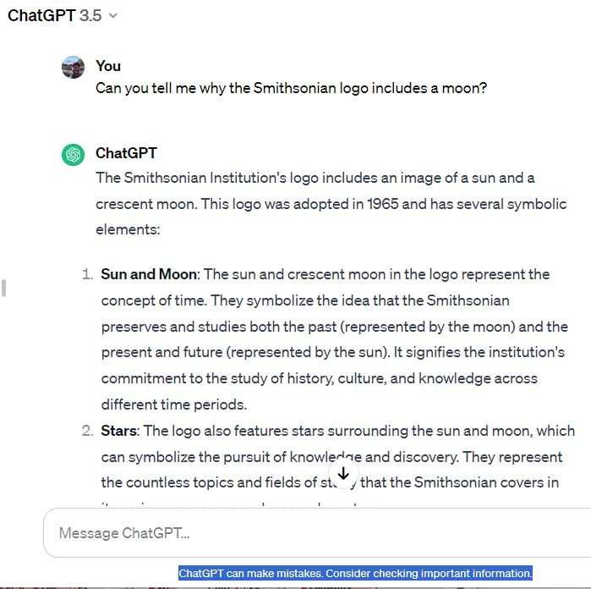

LLMs: Hallucinations
“Hallucinations,” i.e. ChatGPT can make things up completely.

Slide 78
LLMs: Prompt Engineering
Prompt engineering is the process of strategically designing and refining the input prompts given to an LLM, to elicit the most accurate, relevant, and useful responses.
The effectiveness of an LLM's response heavily depends on how the prompt is structured -- different prompts can lead to vastly different outputs, even with the same underlying question or task.

Slide 79
LLMs: Retrieval Augmented Generation
Custom knowledge base search
Full prompt with added context
LLM
Response
Question
Retrieval Query
Retrieved Texts
Knowledge Base

Slide 80
Types of artificial intelligence
AI type-1: Based on Capabilities
3. Super AI:
Super AI is a level of Intelligence of Systems at which machines could surpass human intelligence, and can perform any task better than human with cognitive properties.
It is an outcome of general AI.
Some key characteristics of strong AI include capability include the ability to think, to reason, solve the puzzle, make judgments, plan, learn, and communicate by its own.
Super AI is still a hypothetical concept of Artificial Intelligence. Development of such systems in real is still world changing task.

Slide 81
Types of artificial intelligence
Artificial Intelligence type-2: Based on functionality
Reactive Machines
Purely reactive machines are the most basic types of Artificial Intelligence.
Such AI systems do not store memories or past experiences for future actions.
These machines only focus on current scenarios and react on it as per possible best action.
IBM's Deep Blue system is an example of reactive machines.
Google's AlphaGo is also an example of reactive machines.

Slide 82
Types of artificial intelligence
Artificial Intelligence type-2: Based on functionality
Limited Memory
Limited memory machines can store past experiences or some data for a short period of time.
These machines can use stored data for a limited time period only.
Self-driving cars are one of the best examples of Limited Memory systems. These cars can store recent speed of nearby cars, the distance of other cars, speed limit, and other information to navigate the road.

Slide 83
Types of artificial intelligence
Artificial Intelligence type-2: Based on functionality
Theory of Mind
Theory of Mind AI should understand the human emotions, people, beliefs, and be able to interact socially like humans.
This type of AI machines are still not developed, but researchers are making lots of efforts and improvement for developing such AI machines.

Slide 84
Types of artificial intelligence
Artificial Intelligence type-2: Based on functionality
Self-Awareness
Self-awareness AI Intelligence.
is the future of Artificial
These machines will be super intelligent, and will have their own consciousness, sentiments, and self- awareness.
These machines will be smarter than human mind.
Self-Awareness AI does not exist in reality still and it
is a hypothetical concept.

Slide 85
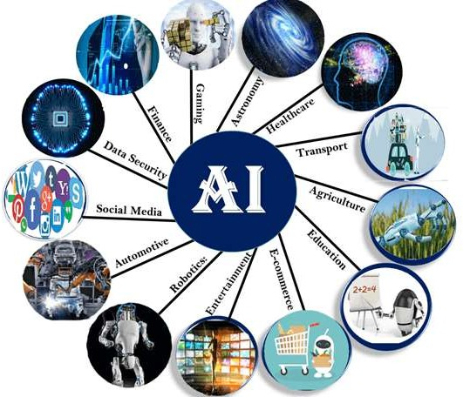
Applications of artificial intelligence

Slide 86
Applications of Artificial Intelligence
AI in Astronomy
Artificial Intelligence can be very useful to solve complex universe problems. AI technology can be helpful for understanding the universe such as how it works, origin, etc.
AI in Healthcare
In the last, five to ten years, AI becoming more advantageous for the healthcare industry and going to have a significant impact on this industry.
Healthcare Industries are applying AI to make a better and faster diagnosis than humans. AI can help doctors with diagnoses and can inform when patients are worsening so that medical help can reach to the patient before hospitalization.
AI in Gaming
AI can be used for gaming purpose. The AI machines can play strategic games like chess, where the machine needs to think of a large number of possible places.

Slide 87
Applications of Artificial Intelligence
AI in Finance
AI and finance industries are the best matches for each other. The finance industry is implementing automation, chatbot, adaptive intelligence, algorithm trading, and machine learning into financial processes.
AI in Data Security
The security of data is crucial for every company and cyber-attacks are growing very rapidly in the digital world. AI can be used to make your data more safe and secure. Some examples such as AEG bot, AI2 Platform,are used to determine software bug and cyber-attacks in a better way.
AI in Social Media
Social Media sites such as Facebook, Twitter, and Snapchat contain billions of user profiles, which need to be stored and managed in a very efficient way. AI can organize and manage massive amounts of data. AI can analyze lots of data to identify the latest trends, hashtag, and requirement of different users.

Slide 88
Applications of Artificial Intelligence
AI in Travel & Transport
AI is becoming highly demanding for travel industries. AI is capable of doing various travel related works such as from making travel arrangement to suggesting the hotels, flights, and best routes to the customers.
Travel industries are using AI-powered chatbots which can make human-like interaction with customers for better and fast response.
AI in Automotive Industry
Some Automotive industries are using AI to provide virtual assistant to their user for better performance. Such as Tesla has introduced TeslaBot, an intelligent virtual assistant.
Various Industries are currently working for developing self-driven cars which can make your journey more safe and secure.
AI in Robotics:
Artificial Intelligence has a remarkable role in Robotics. Usually, general robots are programmed such that they can perform some repetitive task, but with the help of AI, we can create intelligent robots which can perform tasks with their own experiences without pre-programmed.
Humanoid Robots are best examples for AI in robotics, recently the intelligent Humanoid robot named as Erica and Sophia has been developed which can talk and behave like humans.

Slide 89
Applications of Artificial Intelligence
AI in Entertainment
We are currently using some AI based applications in our daily life with some entertainment services such as Netflix or Amazon. With the help of ML/AI algorithms, these services show the recommendations for programs or shows.
AI in Agriculture
Agriculture is an area which requires various resources, labor, money, and time for best result. Now a day's agriculture is becoming digital, and AI is emerging in this field.
Agriculture is applying AI as agriculture robotics, solid and crop
predictive analysis. AI in agriculture can be very helpful for farmers.
12. AI in E-commerce
monitoring,
AI is providing a competitive edge to the e-commerce industry, and it is becoming more demanding in the e-commerce business. AI is helping shoppers to discover associated products with recommended size, color, or even brand.
AI in education:
AI can automate grading so that the tutor can have more time to teach. AI chatbot can communicate with students as a teaching assistant.
AI in the future can be work as a personal virtual tutor for students, which will be accessible easily at any time and any place.

Slide 90
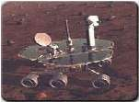

AI Applications
Autonomous Planning & Scheduling:
Autonomous rovers.

Slide 91


AI Applications
Autonomous Planning & Scheduling:
Telescope scheduling

Slide 92



AI Applications
Autonomous Planning & Scheduling:
Analysis of data:

Slide 93


AI Applications
Medicine:
Image guided surgery

Slide 94




AI Applications
Medicine:
Image analysis and enhancement

Slide 95

AI Applications
Transportation:
Autonomous vehicle control:

Slide 96

AI Applications
Transportation:
Pedestrian detection:

Slide 97

AI Applications
Games:

Slide 98

AI Applications
Games:

Slide 99


AI Applications
Robotic toys:

Slide 100
Types of bias in machine learning
Type | Definition
Prejudice bias | Arises when data incorporates cultural, race, gender or stereotypes it should be ignorant of
Selection bias | Introduced by the selection of individuals, groups or data for analysis in such a way that proper randomization is not achieved, thereby ensuring that the sample obtained is not representative of the population intended to be analyzed
Confirmation bias | In the process of refining and reinforcing a models learning, unconsciously or consciously processing data in ways that confirm preexisting beliefs and hypotheses.
Correlation bias | Correlation is not causation. Correlation implies the mutual relation, covariation, or association between two or more variables. It only questions whether the variable varies together or not.
Exclusion bias | Removing data from a set that we think isn’t relevant

Slide 101

Bias in ML

Slide 102

Mitigating bias

Slide 103
Risk and Ethics in AI Projects: SI AI Values Statement
Partnerships
Seek projects and partnerships that adhere to our institutional values.
Partnerships should avoid using tools with unspecified or undisclosed methods and biases.
Partnerships involving artificial intelligence and machine learning tools should explicitly evaluate and state if the datasets or data descriptions used in these tools was collected without consent, or contains offensive or racist descriptions before we agree to use these tools.
Actions
Documentation of dataset biases.
Documentation of intent in methodologies, datasets, collections, algorithms, or tools.
Creator positionality statements.
Documentation of known or potential risks.
Clear labeling of AI-generated content, so it is not confused with human-generated content.
Solicitation and inclusion of feedback from relevant members of the community.

Slide 104
Datasheets for datasets
Activity: Provide comprehensive documentation about a dataset's
creation,
composition,
potential biases,
intended use, and
limitations

Slide 105
Activity
Revisit the machine learning project idea you came up with in the last activity.
What are some potential risks that can arise throughout the lifecycle of your project?
What ethical considerations do you think you should keep in mind when developing a workflow for it?
Discuss 2-3 potential points at which bias may enter the pipeline of your project, and questions/strategies UMU staff might want to consider in order to manage it.

Slide 106
Top Machine Learning Software Tools
Software | Platform | Written in language | Algorithms or Features
Scikit Learn | Linux, Mac OS, Windows | Python, Cython, C, C++ | Classification, Regression Clustering, Preprocessing Model Selection Dimensionality reduction.
PyTorch | Linux, Mac OS, Windows | Python, C++, CUDA | Autograd Module, Optim Module, nn Module
TensorFlow | Linux, Mac OS, Windows | Python, C++, CUDA | Provides a library for dataflow programming.
Weka Waikato Environment for Knowledge Analysis | Linux, Mac OS, Windows | Java | Data preparation, Classification Regression, Clustering Visualization, Association rules mining

Slide 107
Top Machine Learning Software Tools
Software | Platform | Written in language | Algorithms or Features
KNIME Konstanz Information Miner | Linux, Mac OS, Windows | Java | Can work with large data volume. Supports text mining & image mining through plugins
Colab | Cloud Service | - | Supports libraries of PyTorch, Keras, TensorFlow, and OpenCV
Apache Mahout | Cross-platform | Java Scala | Preprocessors, Regression Clustering, Recommenders Distributed Linear Algebra.
Accors.Net | Cross-platform | C# | Classification, Regression, Distribution, Clustering Hypothesis Tests & Kernel Methods, Image, Audio & Signal. & Vision

Slide 108
Top Machine Learning Software Tools
Software | Platform | Written in language | Algorithms or Features
Shogun | Windows Linux UNIX Mac OS | C++ | Regression, Classification Clustering, Support vector machines, Dimensionality reduction, Online learning etc.
Keras.io | Cross-platform | Python | API for neural networks , supports CNN
Rapid Miner | Cross-platform | Java | Data loading & Transformation Data preprocessing & visualization.
Oryx2 | Cross Platform | Python | collaborative filtering, classification, regression , DL, CNN

Slide 109

Python Programming Languages: Some History
“Over six years ago, in December 1989, I was looking for a "hobby" programming project that would keep me occupied during the week around Christmas…I chose Python as a working title for the project, being in a slightly irreverent mood (and a big fan of Monty Python's Flying Circus).”
–Python creator Guido Van Rossum, from the foreward to Programming Python (1st ed.)
Goals:
An easy and intuitive language just as powerful as major competitors
Open source, so anyone can contribute to its development
Code that is as understandable as plain English
Suitability for everyday tasks, allowing for short development times

Slide 110

Compiled Languages
(ex. C++ or Fortran)

Slide 111

Interpreted Languages
(ex. Python or R)
bytecode conversion
Python interpreter: follows bytecode instructions
Source code files
prog.py math.py
Python interpreter
python prog.py
A lot less work is done to get a program to start running compared with compiled
languages!
Python programs start running immediately – no waiting for the compiler to finish.
Bytecodes are an internal representation of the text program that can be efficiently run by the Python interpreter.
The interpreter itself is written in C and is a compiled program.

Slide 112
Getting Python for Yourself: Anaconda
The most popular setup for personal computers
https://www.anaconda.com/download/
Anaconda is a packaged set of programs including the Python language, a huge number of libraries, and several tools.
These include the Spyder development environment and Jupyter notebooks.
Optional – Google Colab (No Installation Needed)
Google Colab:
https://colab.research.google.com/

